Slide 1
Computer Networking

Slide 2
TABLE OF CONTENT
Computer Networks
Computer Network Communication
Types of Networks
LAN
MAN
WAN
Comparison of LAN, MAN, WAN
Network Topology
BUS, RING, STAR Topology
Differences
Conclusion

Slide 3
Computer Networks
Computer Networks Communication

Slide 4
Types of Networks
LAN MAN WAN

Slide 5
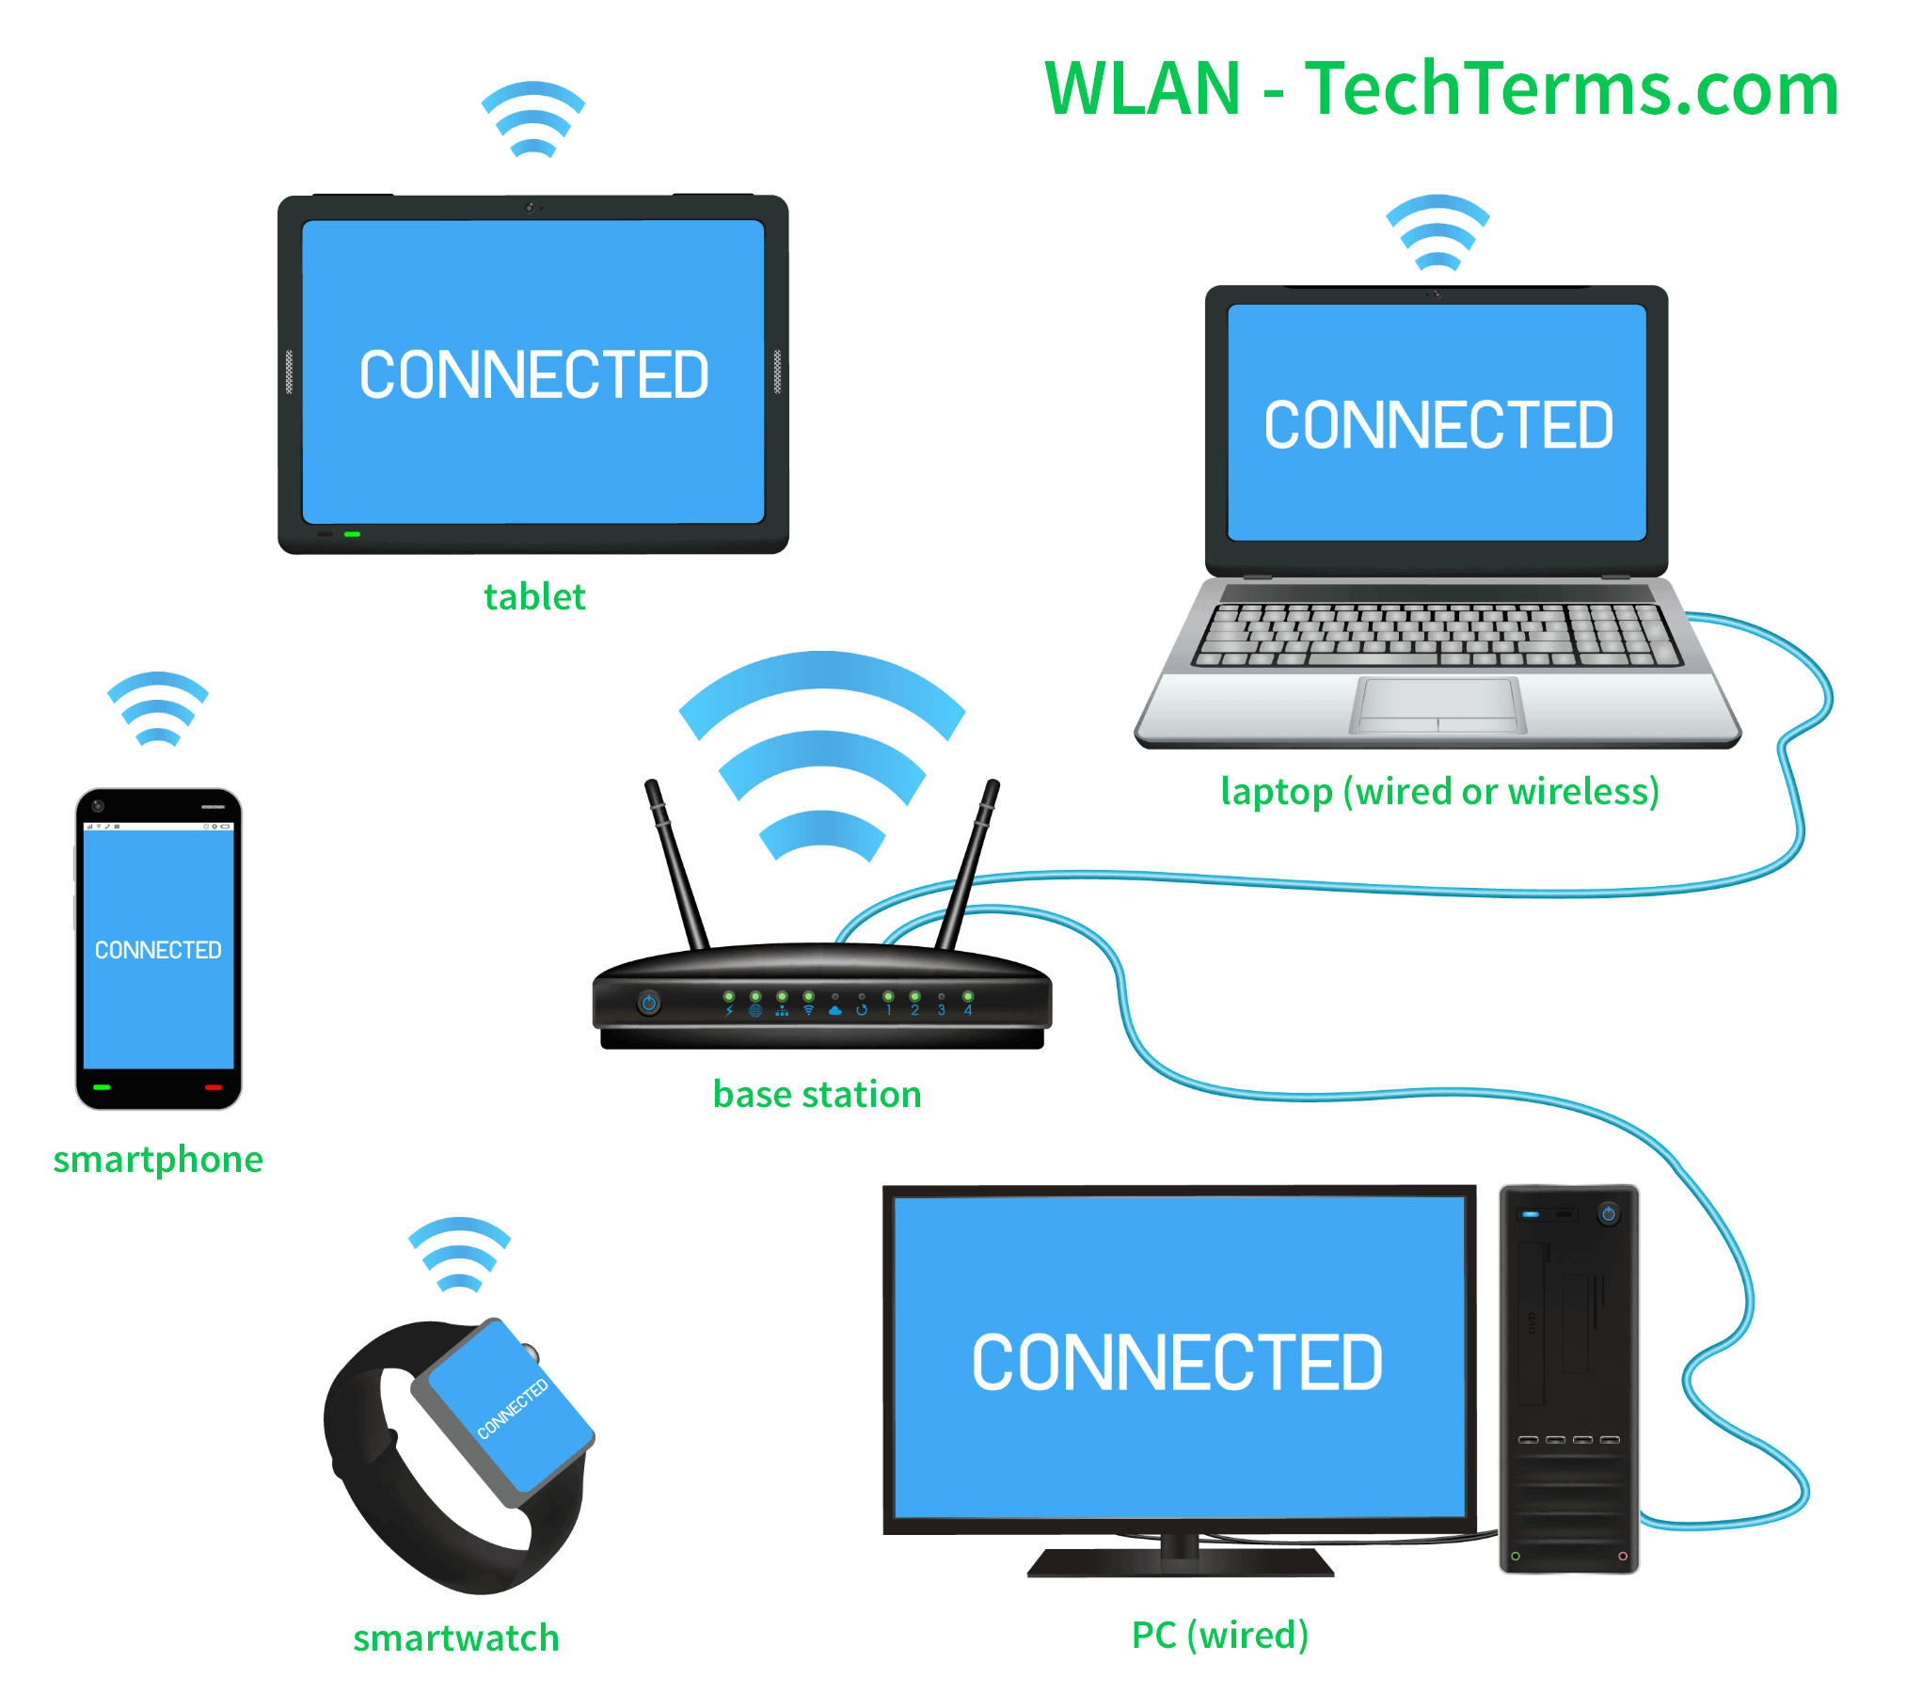
LAN

Slide 6
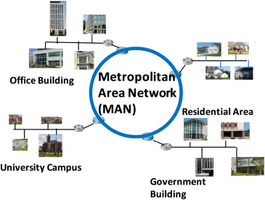
MAN

Slide 7
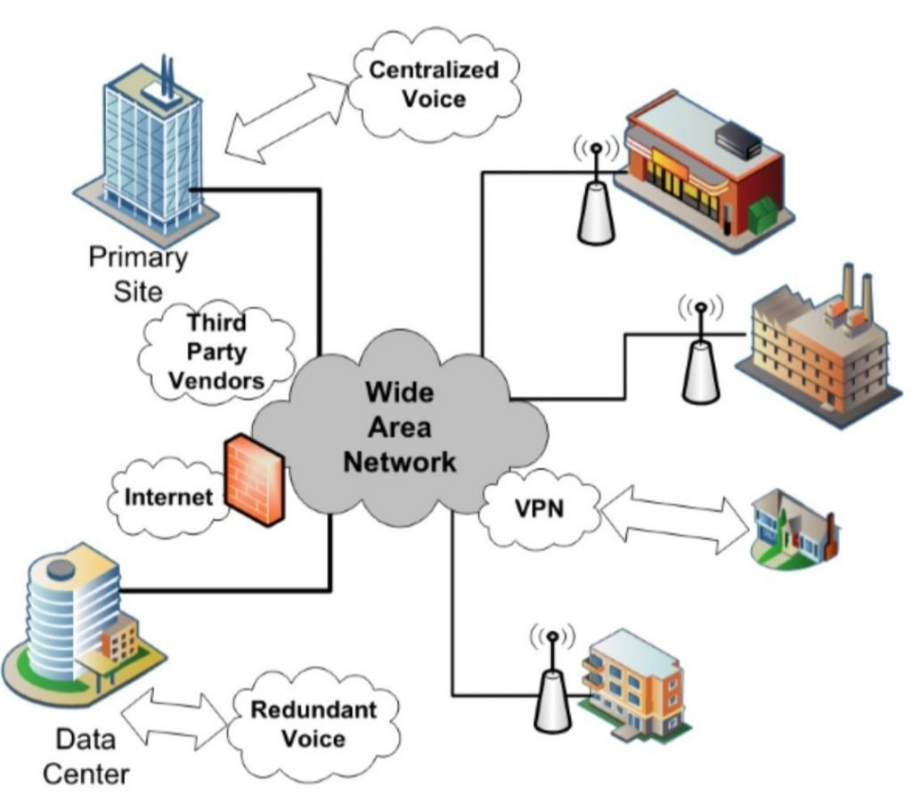
WAN

Slide 8
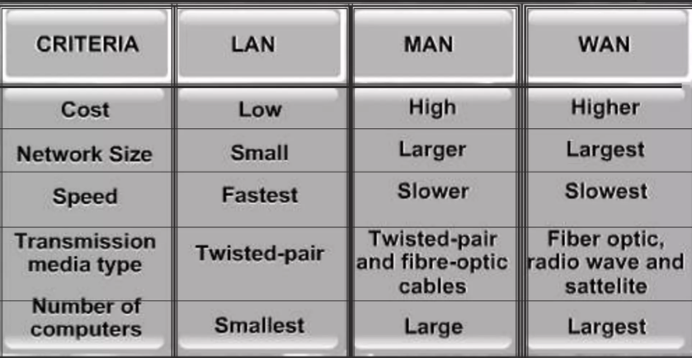

Slide 9
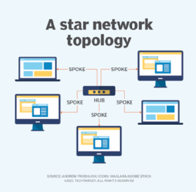
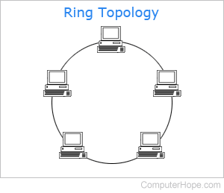
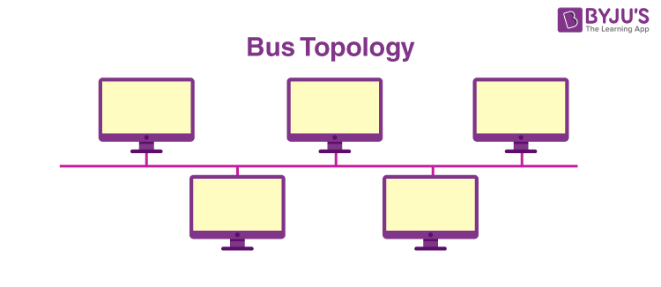

Slide 10
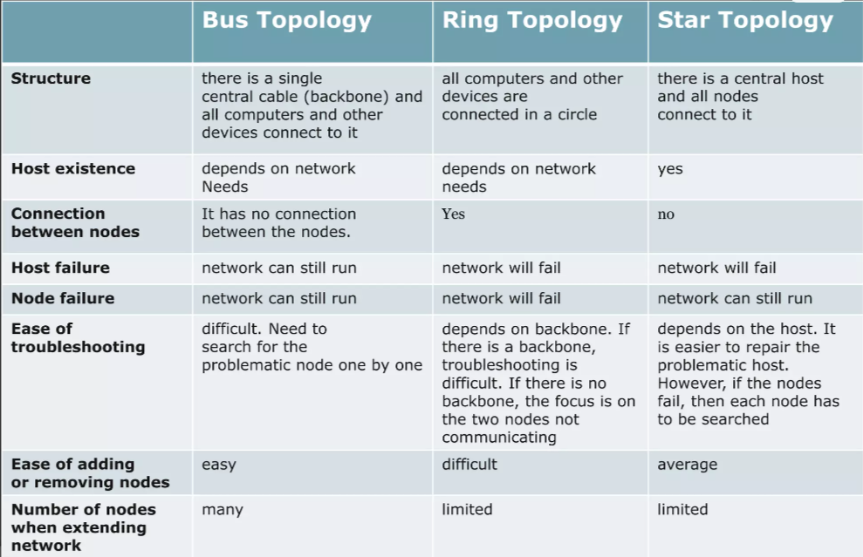

Slide 11
CONCLUSION

Slide 12
THANK YOU
READY FOR YOUR QUESTIONS?

